Slide 1
SALES PERFORMANCE ANALYSIS ON THE COMPETITIE PRODUCTS IN FITNESS INDUSTRY

Slide 2
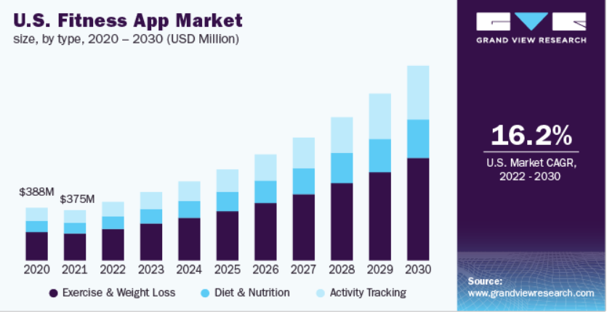
INTRODUCTION
In this Analysis we would be assessing the fitness app market to know where the industry products currently stand and where it would be in the future.
Fitness app provides users with instructions and examples of one or more types of exercise, physical activity, nutritional programs, it can be downloaded on any mobile device and used anywhere to get fit.
The global fitness app market size was valued at USD 1.1 billion in 2021 and is expected to expand at a compound annual growth rate (CAGR) of 17.6% from 2022 to 2030. The spreading COVID-19 pandemic led to nationwide lockdowns followed by social distancing norms, thereby aiding the transition from traditional studios and gyms to virtual fitness. It, in turn, has led to increased downloads and subscriptions of fitness apps. As per a report published by the American College of Sports Medicine (ACSM), it has been stated that fitness apps were ranked at number 13 in accordance with the 2019 fitness trends.

Slide 3
PROBLEM STATEMENT
The Fitness industry at large after the covid has become the big news and its products are vast and last, we want to identify the top competitive products and also identify the top players in the industry.

Slide 4
METHODOLOGY
We are going to carry out an exploratory analysis , we got data from Kaggle here, the data is the market analysis performance for fitness tracker, we would narrow it down to the sales analysis for fitness trackers, smartwatch and fit bands, we would look at the price by device and the average selling price, we would also look at the top key actors in the fitness industry
We also looked at other analysis done by Grand View Research here which covered the other competitive products like Diet & Nutrition, and exercise & weight loss.

Slide 5
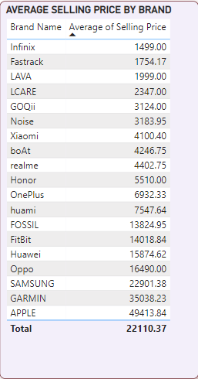
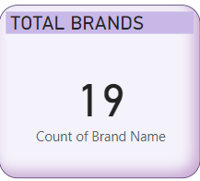
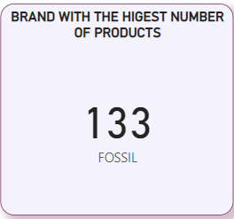

Slide 6
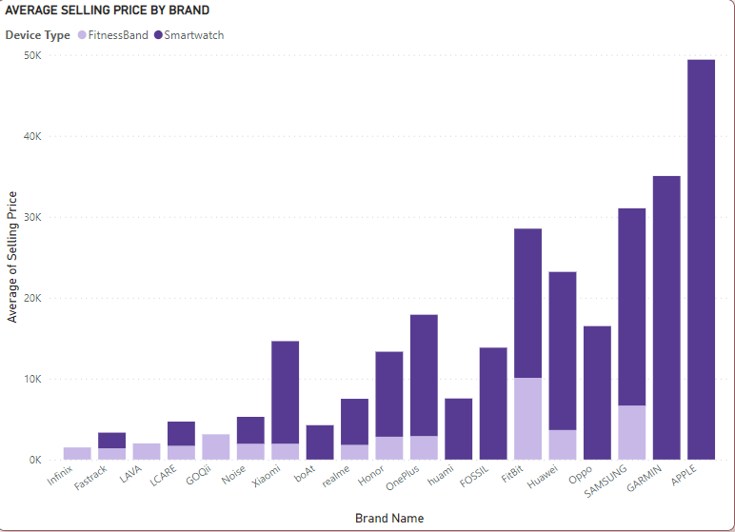
Average Selling Price BY DEVICE TYPE

Slide 7
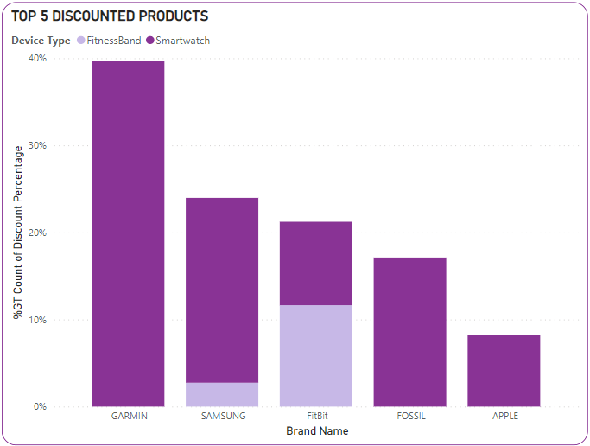
TOP 5 DISCOUNTED PRODUCTS BY BRANDS

Slide 8
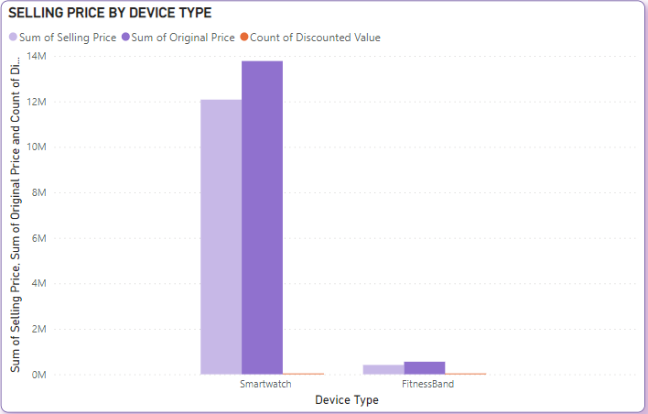
SELLING PRICE

Slide 9
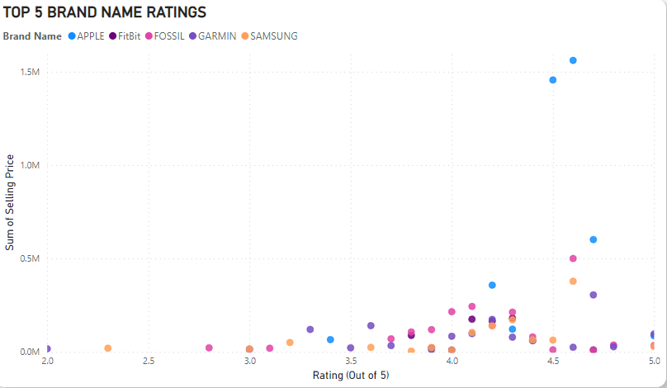
TOP 5 BRANDS AND THEIR RATINGS

Slide 10
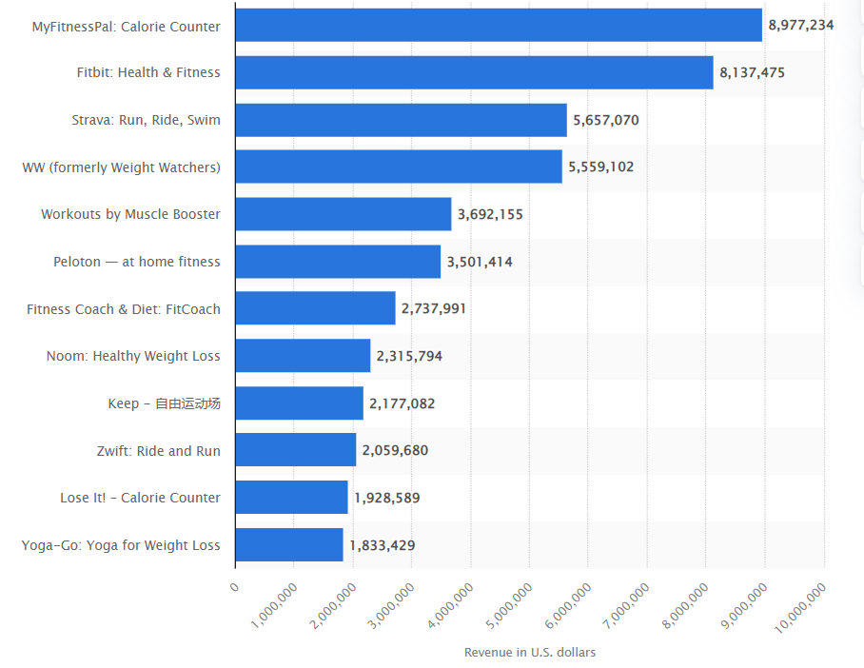
Leading Fitness App by Revenue in March 2022
In March 2022, MyFitnessPal was the leading fitness and sport mobile app, generating in-app revenues of more almost nine million U.S. dollars. Fitbit ranked second, with roughly 8.1 million U.S. dollars in combined revenues via Google Play and Apple App Store. Strava accumulated around 5.6 million U.S. dollars in revenues, while Peloton, the mobile app eponymous of popular stationary bikes and treadmills, generated IAP revenues of roughly 3.5 million U.S. dollars during the month

Slide 11
These apps are utilizing machine learning, artificial intelligence, and other technologies to offer personalized fitness plans to their customers. They also offer personalized diet charts, no equipment workout routines, track footsteps, monitor diet, and also provide personalized health and fitness coaches.
Such offerings and advantages over brick and mortars are expected to increase the growth potential of the market. For instance, MyFitnessPal offers personalized diet and activity tracking to its users, generating a revenue of USD 6.7 million in June 2020. In addition, wearable technology has remained the leading fitness trend for 2019.
Health and fitness apps show the highest retention rates across all categories with 96.0% of users using only one of these apps.
Another major factor aiding the market growth is the increasing penetration of smartphones worldwide. As per the Mobile Economy Survey 2018, smartphone penetration is projected to increase from 57.0% in 2017 to 77.0% by 2025. In addition, as per the Mobile Economy 2018 survey, unique mobile subscribers are anticipated to reach 5.9 billion by 2025. Moreover, the growing adoption of wearable devices including Fitbit and Apple Watch will further aid the market growth.

Slide 12
RECOMMENDATIONS
From the data and insights derived from the grand view research , the major competitive products are segmented into 3 parts
Exercise & weightloss
Diet & Nutrition
Activity Tracking Device
Exercise and weight loss segment held the largest revenue share of over 50.0% in 2021. In our FIT-STAT app we encourage users to exercise often with the help of scheduled notifications and ease modify the step/process of tracking/monitoring calorie intake (daily) to a macronutrient level, such as fats and carbohydrates, as well as provide a customized lifestyle plan based on user feed data with the following features
audio cues
video demos
fitness tracking to maintain exercise routine.
The activity tracking segment is anticipated to register a significant CAGR over the forecast period. As per a new IDC report, the demand for smartwatches is anticipated to surpass consumer interest in fitness trackers. However, as per Fitbit, fitness trackers have been still witnessing high demand over the last few years and are expected to register the highest growth rate during the forecast period.

